Slide 1
Project Title: ELIMINATING UNACCOUNTED DEFERMENT IN AGBADA 2 FLOW STATION
Charter Template
Business Case/objectives:
Agbada 2 FS has 33 flowing strings. Current IPSC is set at 22,154bopd. Agbada 2 FS has experienced unaccounted deferment due to uncertainties. These uncertainties can be traced to a number issues including export metering inaccuracies, inefficient gas lifting, improper deferment booking, irregularities with well testing, etc. Over the last one year, Unaccounted deferment has amounted to an average of circa 12,000bbls/d.
This proposal aims to investigate and eliminate unaccounted oil deferment in Agbada 2 FS by 50%.
Potential Benefits & Measurement:
Station gross factor of 0.95- 1.05
Improved reconciliation factor
Production gain of circa 5700bopd/d
Project Scope/Actions :
Test and Validate all Wells to establish well potentials
Assess and Service/Revamp Test and export metering systems
Improve deferment reporting and timing accuracies (eliminate omitted deferment reporting)
Identify and rectify all faults on gas lift instrumentation
Review and update (where applicable), well test procedures to improve accuracy of tests and samples
Review water-cut measurement accuracy
Review procedures for assessing tests of Wells currently bulked in production
Critical Success Factors:
Support from HCA/Asset Programmers
Budget Availability
Leadership support
High-level Timeline:
L0-L1: Assess and Identify the value and impact of unaccounted deferment in AGBD F2 – Mar 10, 2018
L2: Identify main investigation themes and develop methodologies for each theme – March 16, 2018
L3: Develop plans/schedules for each theme March 30, 2018
L4: Implement Plans in each theme in line with Schedule & Plans14th May, 2018
L5: Monitor and track improvement in unaccounted Deferment, SGF and RF 30th May, 2018
Initiative End : 5th June, 2018
Project Sponsor: Babatunde Alepaye / Wilcox Emmanuel
Implementation Lead: Aniemeke Samuel
Project Team: Mamoke Akporuno, BT Nongo, Nwoke Sunny, Olawunmi Temitope, Dan-Arthur Nwaogu, Ogbonna Innocent, Omoniwa Helen, Jamilu Buhari, Kalio Samuel; Nwakile, C. Emuke L.,

Slide 2
Bi-Weekly Cadence Commitment Template Past 7 days
No. | Action | Action Party | Threat | Due Date | Status
 | Test 8 nos. wells using Test Separator 1 | Nwoke S | IAP SD/TNP
 | Validate the 8 nos. tested wells | Mamoke A. | IAP SD/TNP
 | Update IPSC with current accepted well test data | Mamoke A. | IAP SD/TNP
New
On track
At risk
Delayed
Completed

Slide 3
Bi-Weekly Cadence Commitment Template Next 14days
No. | Action | Action Party | Threat | Due Date | Status
10-4.1 | Test 8 nos. wells using Test Separator 1 | Nwoke S | MER
10-4.2 | Validate the 8 nos. tested wells | Mamoke A. | MER
10-4.3 | Update IPSC with current accepted well test data | Mamoke A. | MER
10-4.4 | Review Gaslift Volumes for 4 nos. wells | Aniemeke S. | Nil
10-4.5 | Function test Gaslift system for 4 nos Wells | Ebibo E. | PACO Resource
10-4.6
10-4.7
10-4.8
10-4.9
10-4.10
10-4.11
10-4.12
10-4.13
10-4.14
10-4.15
10-4.16
New
On track
At risk
Delayed
Completed

Slide 4
Overall Project Plan
 | 2013 { $2.881(Budget) / $2.815(Actuals and Total Expected Charges for the remainder of the year) } |  |  |  |  |  |  |  |  |  |  |  |  |  |  |  |  |  |  |  | 2014 |  |  |  |  |  |  |  |  |  |  |  | 2015
Work Streams | Mar |  | Apr |  | May |  | Jun |  | Jul |  | Aug |  | Sep |  | Oct |  | Nov |  | Dec |  | J | F | M | A | M | J | J | A | S | O | N | D | Jan – Dec
Actual / LE | - |  | - |  | $53.6K |  | $229.9K |  | $171.8K |  | $245.5K |  | $481.3K |  | $708.2K |  | $488.8K |  | $436.1K |  | $40M
Programme Management
Change Management
Information Architecture
&
Value
Migration
On Track
At Risk
Delayed
Completed
Key Milestone
Key Dependency

Slide 5
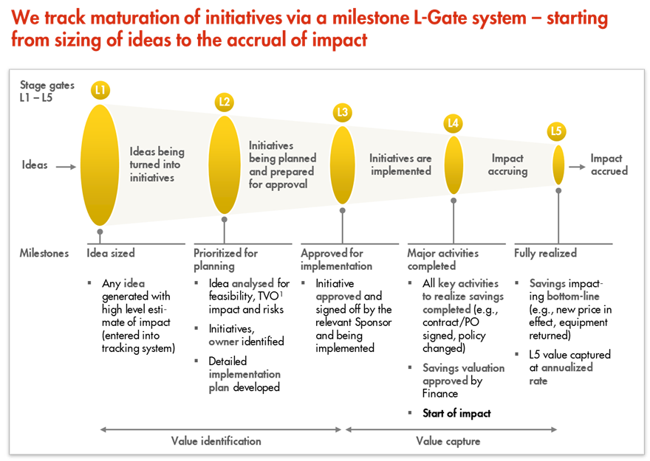
L1 – L5 Gates

Slide 6
Cadence Commitment Template
No. | Action | Action Party | Threat | Due Date | Status
1
2
3
4
5
6
7
8
9
10

